Slide 1
Chapter 16
Computer Graphics and Entertainment: Movies, Games, and Virtual Communities

Slide 2
Learning Objectives (1 of 2)
Describe the changes in movie animation techniques caused by computer generated imagery (CGI)
List the steps in the graphics pipeline
Explain how to create a computer model of a 3D object
Understand how a transformation matrix can model the movement of an object
Name three challenges involved in rendering a visual object

Slide 3
Learning Objectives (2 of 2)
Explain the purpose and function of a graphics processing unit (GPU)
List and explain two techniques for achieving the real-time graphics required for video-game animation as opposed to movie animation
Describe how large virtual communities work, and the particular challenges they face

Slide 4
Introduction (1 of 2)
Early computers were too expensive and rare for use as entertainment (1950s–1960s)
When minicomputers arrived, college students began writing games for them (1970s)
Atari created Pong, first commercial game (1975)
Use in movies grew in early 1990s (Terminator 2, Jurassic Park)
Now entertainment is a huge, multi-billion dollar segment of the industry

Slide 5
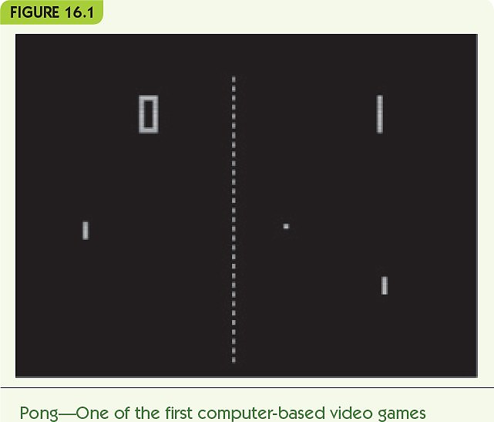
Introduction (2 of 2)
Invitation to Computer Science, 8th Edition © 2019 Cengage. All rights reserved.

Slide 6
Computer-Generated Imagery (CGI) (1 of 18)
Movie animation in the past
Hand-drawn (e.g., Walt Disney)
Stop-motion animation
Clay figures posed, photographed, then moved slightly repeatedly in a series of frames
Computer animation developed in the 1980s and 1990s
Terminator 2: Judgment Day
Jurassic Park
Computer-generated imagery (CGI) produces photorealistic animation

Slide 7
Computer-Generated Imagery (CGI) (2 of 18)
The graphics pipeline: sequence of tasks to generate CGI images/movies
Object modeling: create model of 3D object
Object motion: apply transformations to move objects
Rendering and display: incorporate lighting, shadows, and textures

Slide 8
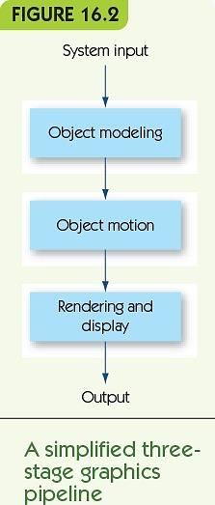
Computer-Generated Imagery (CGI) (3 of 18)
Invitation to Computer Science, 8th Edition © 2019 Cengage. All rights reserved.

Slide 9
Computer-Generated Imagery (CGI) (4 of 18)
Wireframe modeling is a common approach to object modeling
Take an image and create a tessellation
Divide object surface into planar polygons
Polygons share edges and vertices
Polygons completely cover object surface
Polygon mesh: result looks like a wire model
Convert to three dimensions
Generate a vertex list, a table of all vertices and their 3D position

Slide 10
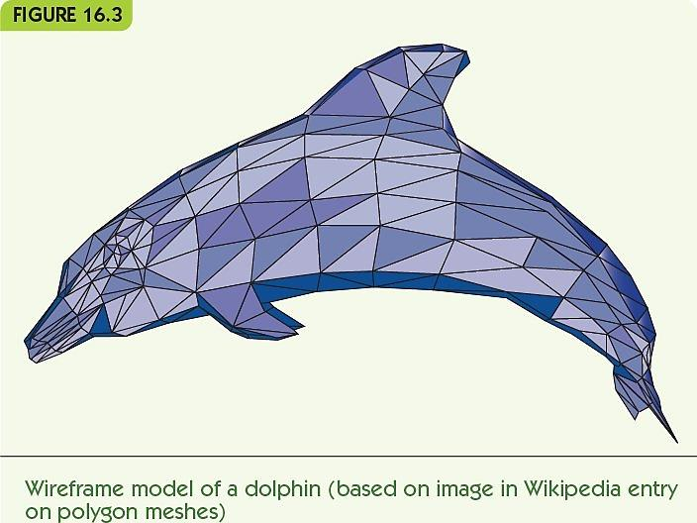
Computer-Generated Imagery (CGI) (5 of 18)
Invitation to Computer Science, 8th Edition © 2019 Cengage. All rights reserved.

Slide 11
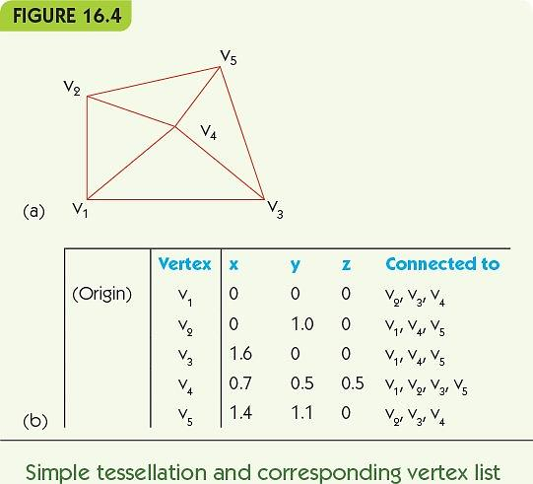
Computer-Generated Imagery (CGI) (6 of 18)
Invitation to Computer Science, 8th Edition © 2019 Cengage. All rights reserved.

Slide 12
Computer-Generated Imagery (CGI) (7 of 18)
Object motion: rigid or deforming
Rigid motion: movement that does not change object’s shape
Translation: lateral movement, every point changes by the same amount in all three dimensions
Rotation: circular movement around a fixed point/axis
Reflection: mirror image of object

Slide 13
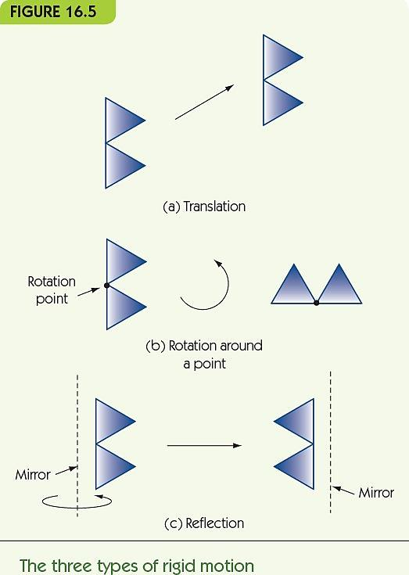
Computer-Generated Imagery (CGI) (8 of 18)
Invitation to Computer Science, 8th Edition © 2019 Cengage. All rights reserved.

Slide 14
Computer-Generated Imagery (CGI) (9 of 18)
Implement movements using matrix multiplication
Transformation matrix
Defines a particular motion
Multiply vector for vertex position (x, y, z) by transformation matrix
Result is a new location for that point, as a vector
Example: move point at (x, y, z) to (x+a, y+b, z+c)
Create motion by repeating for small a, b, c
Keyframing: user gives start and end positions, computer generates the intermediate movements

Slide 15
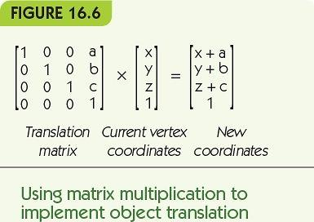
Computer-Generated Imagery (CGI) (10 of 18)
Invitation to Computer Science, 8th Edition © 2019 Cengage. All rights reserved.

Slide 16
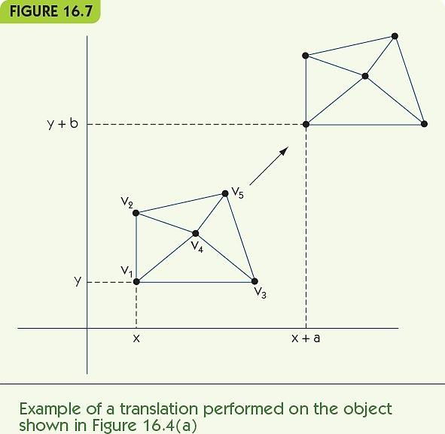
Computer-Generated Imagery (CGI) (11 of 18)
Invitation to Computer Science, 8th Edition © 2019 Cengage. All rights reserved.

Slide 17
Computer-Generated Imagery (CGI) (12 of 18)
Control point (animation variable): a point or axis used to control motion
Multiple control points allow movement of parts of an object
Example: two rotation axes
One rotates right circle around center point
One rotates both circles around external point

Slide 18
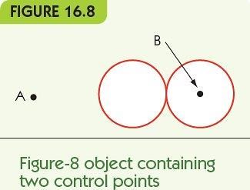
Computer-Generated Imagery (CGI) (13 of 18)
Invitation to Computer Science, 8th Edition © 2019 Cengage. All rights reserved.

Slide 19
Computer-Generated Imagery (CGI) (14 of 18)
Rendering converts a model to a full 3D image
Lighting
Fix the location and intensity of all light sources
Determine the effects on objects
Color shading
Assign colors to vertices; blend across polygons
Shadows
Account for shadows from other objects
Texture mapping
Apply variable surfaces to polygons
Blur to show motion

Slide 20
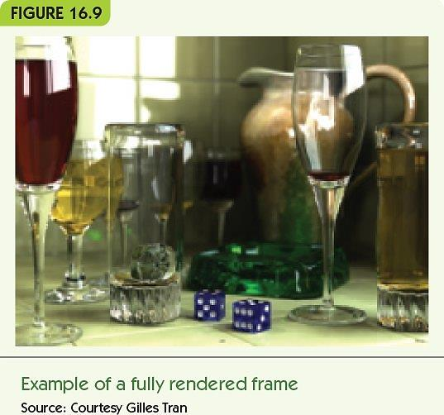
Computer-Generated Imagery (CGI) (15 of 18)
Invitation to Computer Science, 8th Edition © 2019 Cengage. All rights reserved.

Slide 21
Computer-Generated Imagery (CGI) (16 of 18)
Ray tracing is the most common rendering algorithm
Repeats for each polygon in the object
For each light source, determine the amount and direction of light from that source
Combine light sources and determine intensity, color shading, brightness
Last step: convert 3D objects to a 2D image
Locate viewer; use geometry to determine the view

Slide 22
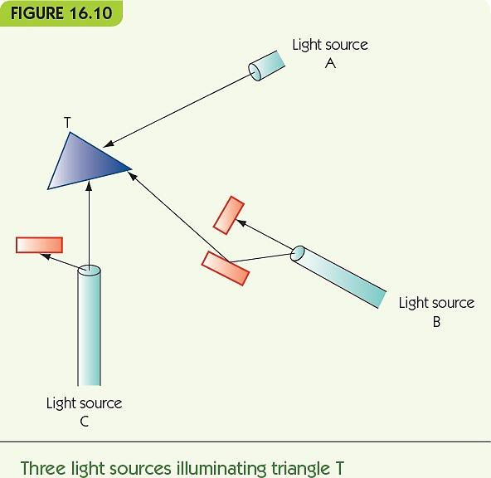
Computer-Generated Imagery (CGI) (17 of 18)
Invitation to Computer Science, 8th Edition © 2019 Cengage. All rights reserved.

Slide 23
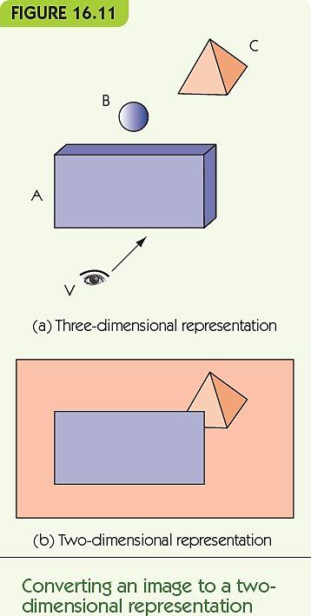
Computer-Generated Imagery (CGI) (18 of 18)
Invitation to Computer Science, 8th Edition © 2019 Cengage. All rights reserved.

Slide 24
Video Gaming (1 of 4)
Video-game images are similar to CGI
CGI assumes a static environment
Unlimited time to produce the images
Created once and shown many times
Video games are a dynamic environment
User choices change what must be displayed
Must render images in real-time: real-time graphics
“If necessary, sacrifice image quality
for speed of display”

Slide 25
Video Gaming (2 of 4)
Frame rate is speed of image generation
Computers improve frame rate with a dedicated GPU
Graphics processing unit (GPU)
A separate processor optimized for CGI
Dedicated video memory on a video card (graphics card)
Most contemporary computers have GPUs
Some have multiple GPUs

Slide 26
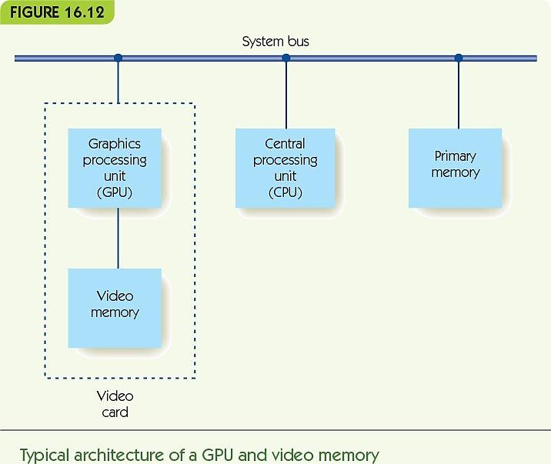
Video Gaming (3 of 4)
Invitation to Computer Science, 8th Edition © 2019 Cengage. All rights reserved.

Slide 27
Video Gaming (4 of 4)
Other methods for achieving real-time graphics
Avoid time-consuming algorithms (e.g., ray tracing)
Use fixed colors, with no shadows or shading
Culling: first determine what is visible, and only render visible elements
Cut-ins: pre-computed fully rendered objects
Stored in a video library
Dropped into the frame as needed

Slide 28
Multiplayer Games and Virtual Communities (1 of 4)
Massively multiplayer online games (MMOG)
Thousands of players
Simulated virtual world
Example: World of Warcraft
Game provided by online game servers
Game world is always available and running
Users log into the game with client software

Slide 29
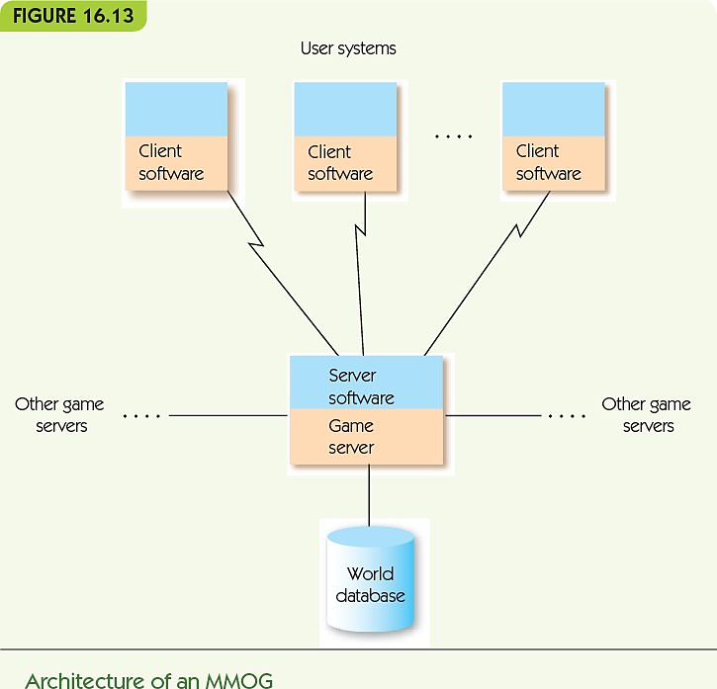
Multiplayer Games and Virtual Communities (2 of 4)
Invitation to Computer Science, 8th Edition © 2019 Cengage. All rights reserved.

Slide 30
Multiplayer Games and Virtual Communities (3 of 4)
MMOG game designers must perform:
Game play management
Control game actions and render game images
Registration management
Control user accounts, new and returning users
Client/server protocols for multiple servers and thousands of clients
Security to ensure authorized access only
Database storage and retrieval
Store huge amounts of data, retrieve quickly

Slide 31
Multiplayer Games and Virtual Communities (4 of 4)
Virtual communities:
Noncompetitive MMOG, or metaverse
Goal is not to score points or win, but to explore and interact, create, and engage in virtual commerce
Example: Second Life, by Linden Labs
Several thousand servers
100 trillion bytes of data
1 million active “residents”
~50,000 online at any one time

Slide 32
Summary (1 of 2)
Use of computers and computer animation in the entertainment industry has grown as the power of computers has grown
CGI allows for photorealistic animation
The graphics pipeline includes object modeling, object motion, and rendering and display
Objects are commonly modeled as tessellations of polygons in three dimensions
Motion is created through matrix multiplication of transformation matrices with vertices of an object

Slide 33
Summary (2 of 2)
Rendering must apply color, shading, and texture to images
Ray tracing is a common technique for rendering
Video games must render images in real time
GPUs perform video operations to speed up render time
MMOGs are online games, large-scale computing
Virtual communities like Second Life are noncompetitive MMOGs

